Slide 1
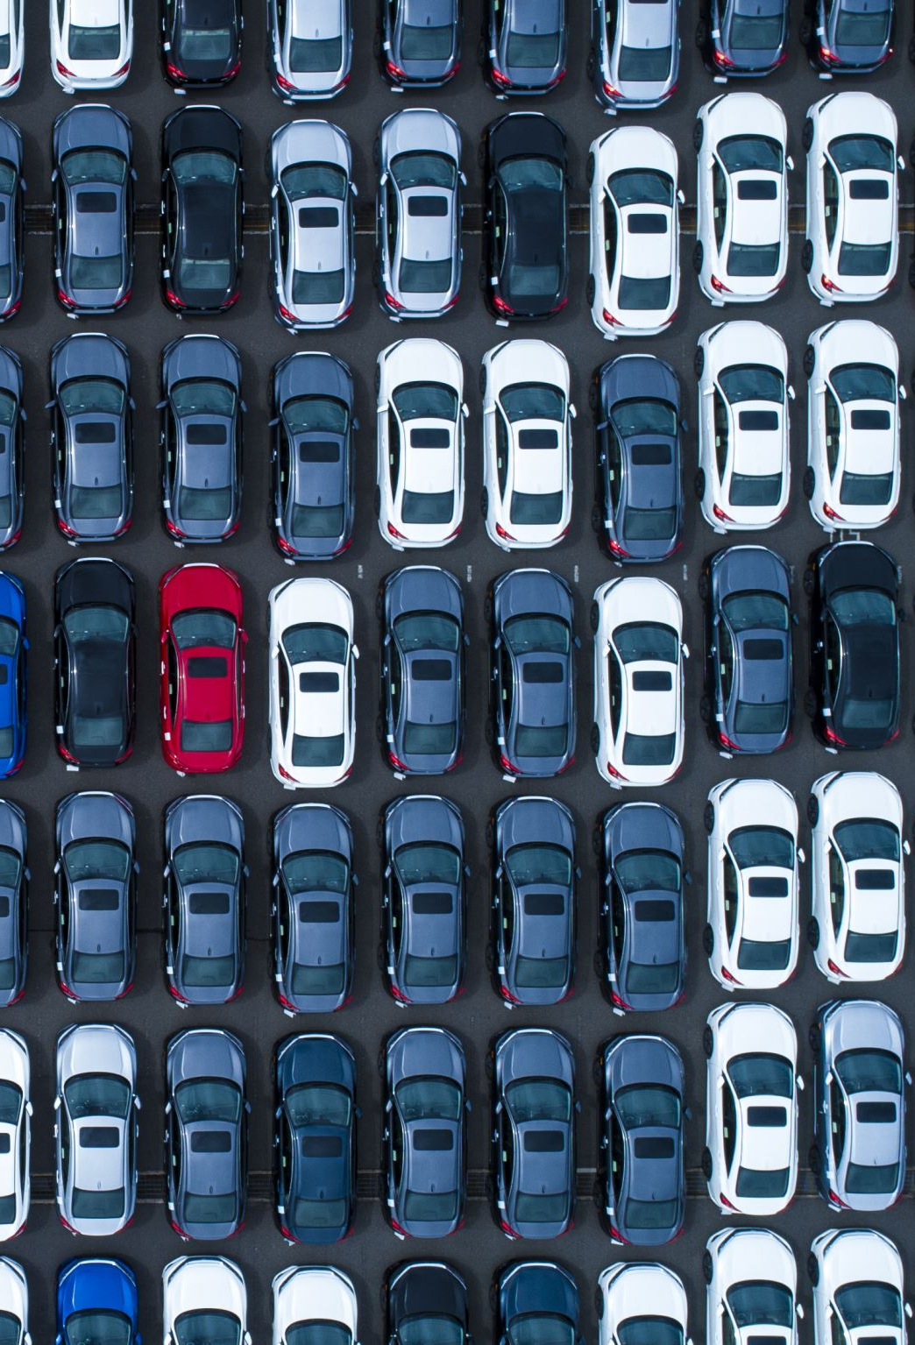
Car Damage Classification For insurance verification
Course: ML 2
Student: Durmishkhan(Ucha) Gigineishvili
July, 2025

Slide 2

Introduction & Motivation
Why is it economics related?
insurance fraud detection
automation/reducing losses/costs
reducing corruption

Slide 3
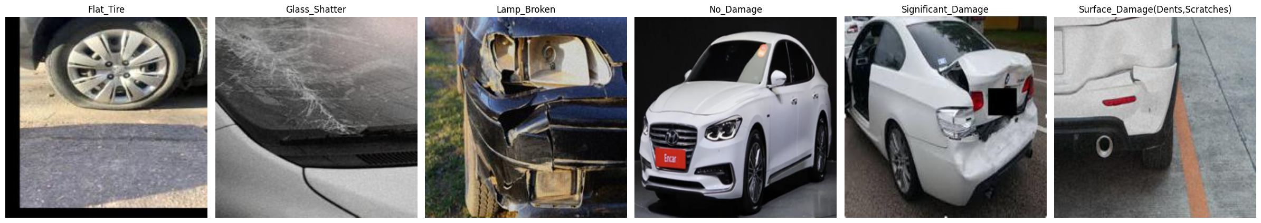
Datasets OvervieW & Preprocessing:
Data sources: 3 different Kaggle datasets used to collect the 6 classes
Classes: 1) Flat_Tire
2)Glass shatter
3)Lamp broken
4)No damage 5)Significant damage
6) Surface damage (dents , scratches)

Slide 4
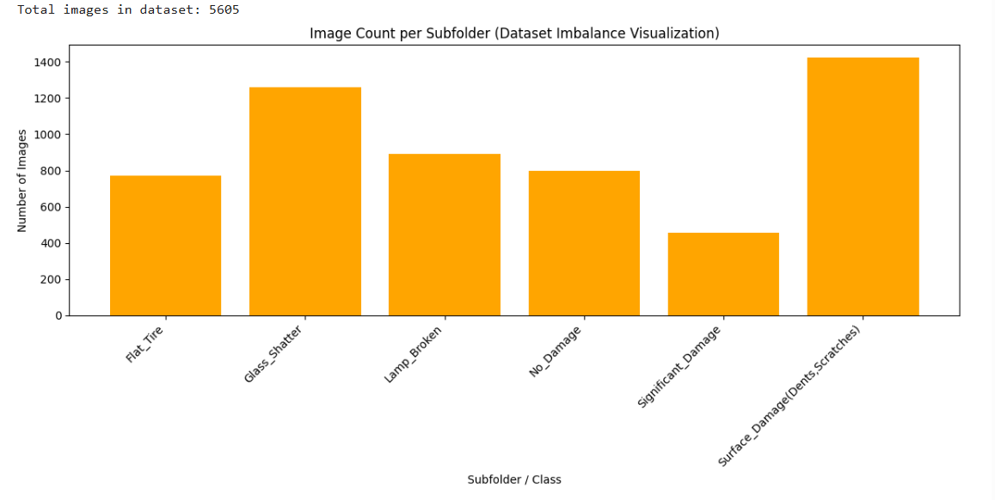
Initial raw dataset imbalance visualization:

Slide 5
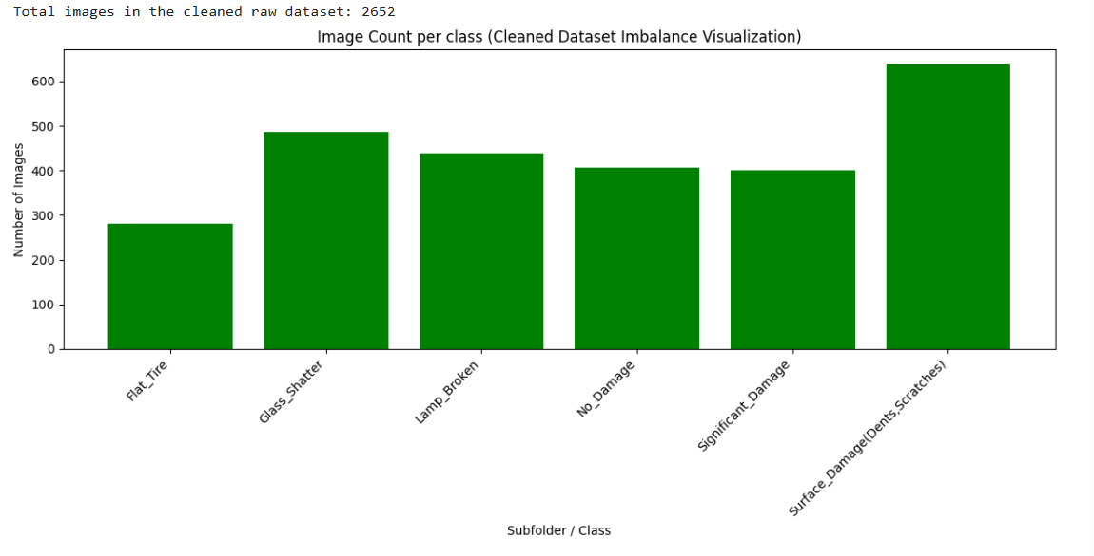
Initial dataset distribution after cleaning from duplicates and similar redundant pictures:

Slide 6




Then I separated dataset manually into Train, Validation and test parts.
120-120 per class for validation-test. In total 720-720 validation-test unique pictures, remaining were dedicated to train set.

Slide 7
Augmentations used on train set to upscale remaining pictures to 700 per class:
Random horizontal flip
Collor jitter
Random rotation
Random affine
Random perspective
Gaussian blur

Slide 8
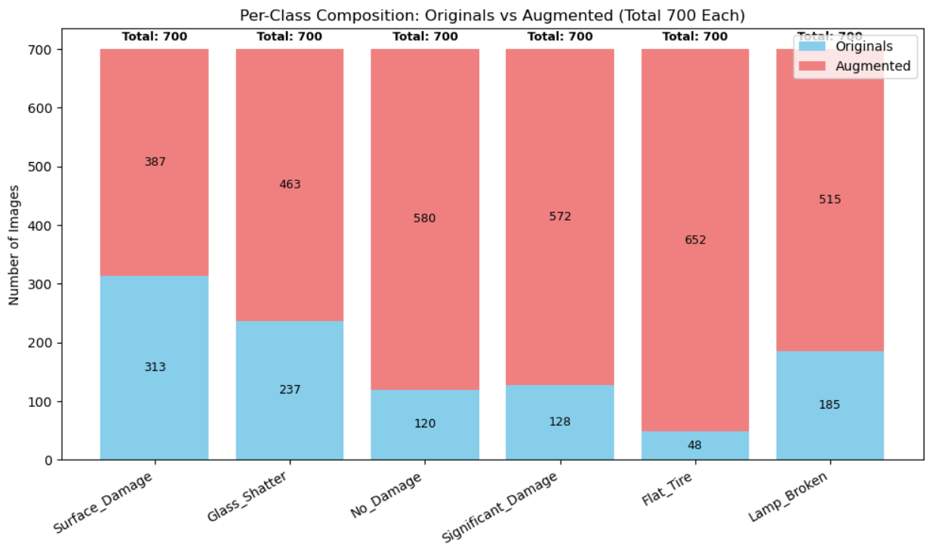
Data augmentation results:

Slide 9
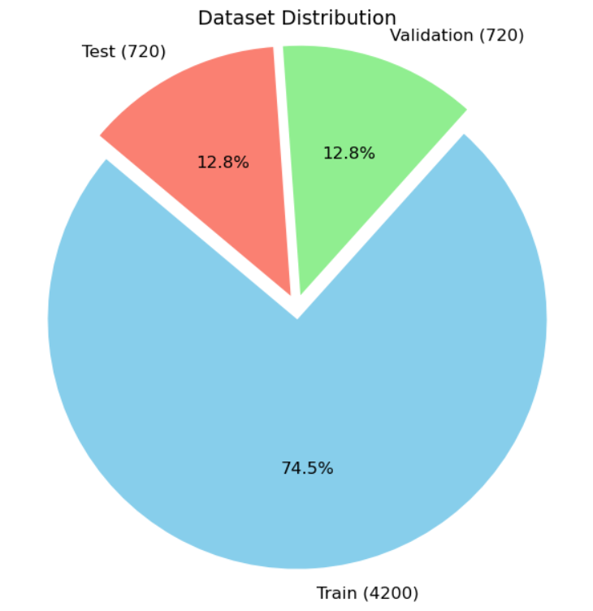
The final dataset structure used:
Train: 4200 pictures
Test: 720 pictures
Validation: 720 pictures

Slide 10


The scratch model characteristics
6 convolutional layers
Pooling+Batchnorm2d at the end of each layer
Fcnn with 4 main layers with batchnorm1d+dropout

Slide 11
The training loop characteristics:
Model parameters with best validation gets saved automatically
ADAM optimizer used
Early stopping: Patience of 5 epochs
Flexible learning rate schedule: ReduceLRonPlateau function with patience 2 , coefficient 0.5

Slide 12

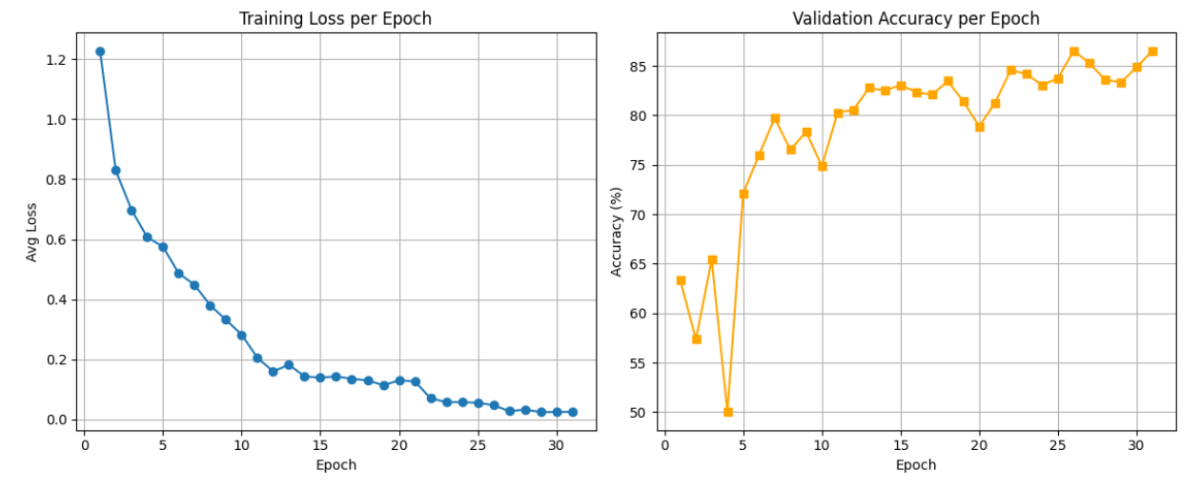



Training Results

Slide 13
Results in terms of peak validation percentage and the test set result:
Validation peak: 86.5%
Result on test set: 84.72% accuracy
Inference about overfitting: slightly overfitted to the validation set

Slide 14
Results analysis:
1) Per class accuracy
2) Confusion matrix
3) Confidence interval for the average model accuracy
4) Confidence intervals for per class accuracies

Slide 15
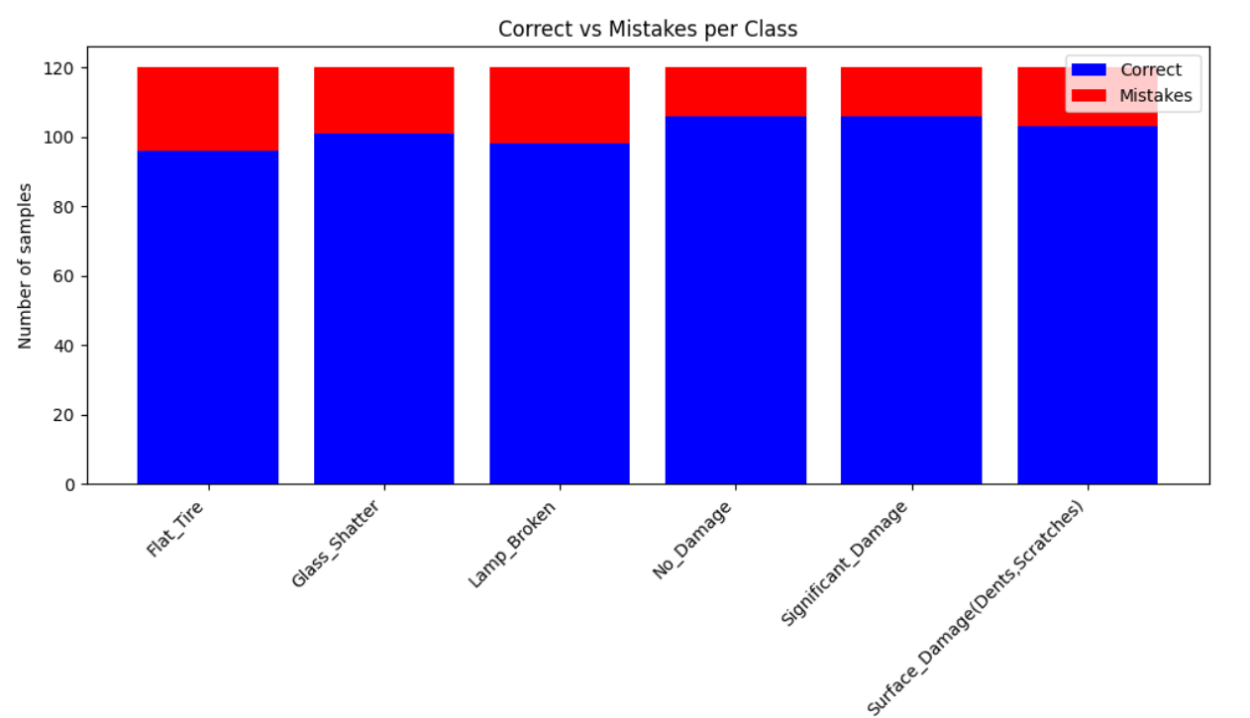
Per class accuracy:
Per-Class Accuracy:
Flat_Tire : 96/120 -> 80.00%
Glass Shatter : 101/120 -> 84.17% Lamp Broken : 98/120 -> 81.67%
No Damage : 106/120 -> 88.33% Significant Damage: 106/120 -> 88.33%
Surface Damage(Dents , Scratches): 103/120 -> 85.83%

Slide 16
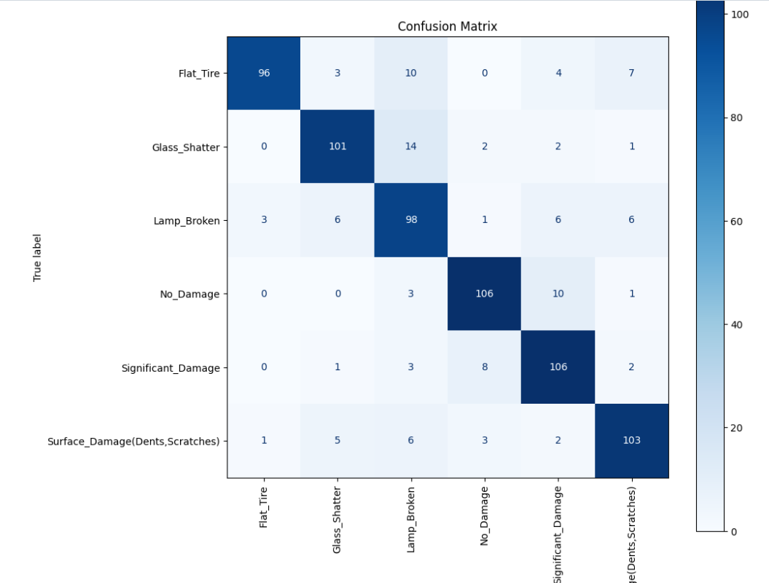
Confusion matrix showing what class the model confused with incorrect another one:

Slide 17
I also tried training on residuals and combining the results, but model was not able to get any useful additional useful information
Result of the training:
Scratch Model Accuracy: 84.72% Combined Model Accuracy after Residual Training: 84.58% ⚠️ No improvement after residual training. Using original model predictions

Slide 18
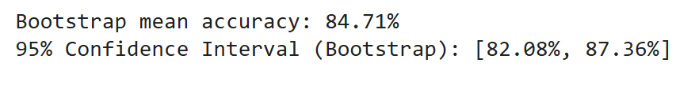
Developing approximated 95% confidence interval for aggregated model accuracy using bootstrap sampling
100k bootstrap samples used
Results:

Slide 19
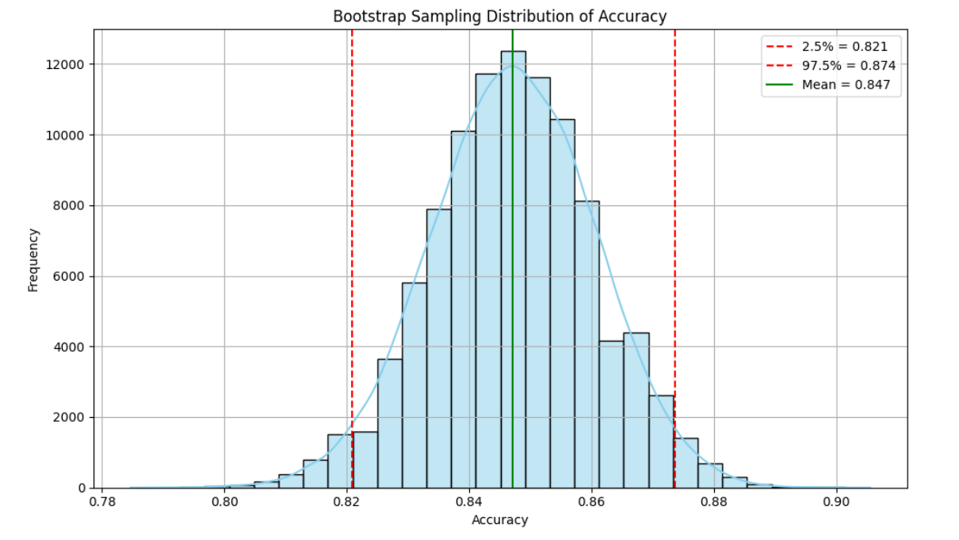
How my bootstrap sampling distribution of model accuracy looks like

Slide 20
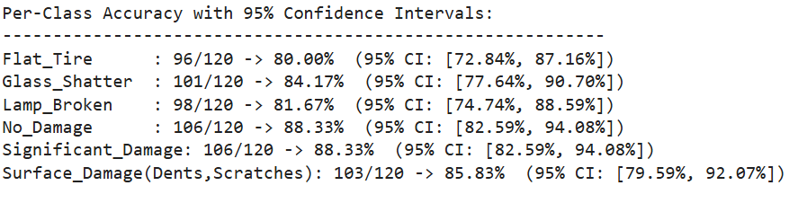
95% confidence intervals for per class accuracies using binomial distribution.

Slide 21
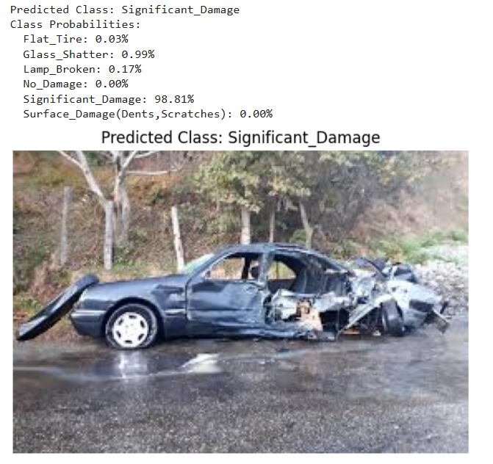
Testing my model on some external unseen picture:

Slide 22
Now the final upgrade, using pretrained model Resnet50
Trained FCNN part for 5 epochs
Another 5 epochs unfreezed last convolutional block of the Resnet 50
Finally with patience 5, ReduceLRonPlateatu LR scheduler, and validation tracking unfreezed and trained using whole Resnet50 model

Slide 23
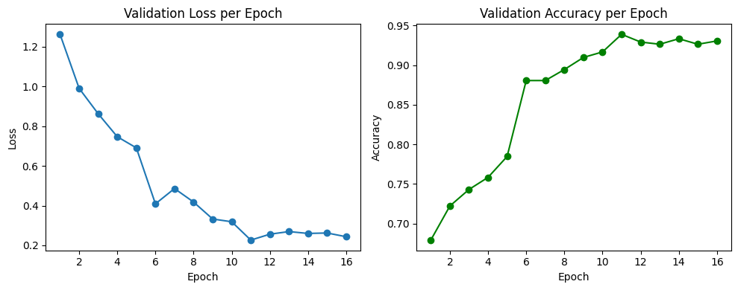
Pretrained model training results:

Slide 24
Pretrained model Validation vs Test accuracy:
Validation peak: 93.9%
Accuracy on the test set: 94.1

Slide 25
Per class accuracies: Flat Tire : 112/120 -> 93.33% Glass Shatter : 113/120 -> 94.17% Lamp Broken : 113/120 -> 94.17% No Damage : 116/120 -> 96.67% Significant Damage: 114/120 -> 95.00% Surface Damage(Dents , Scratches): 109/120 -> 90.83%

Slide 26
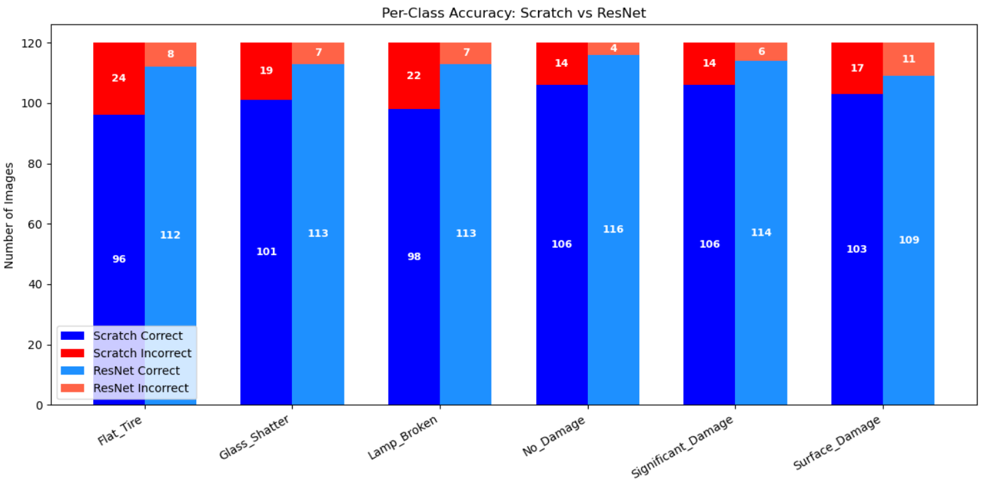
Comparison of scratch model per class accuracy vs pretrained model

Slide 27
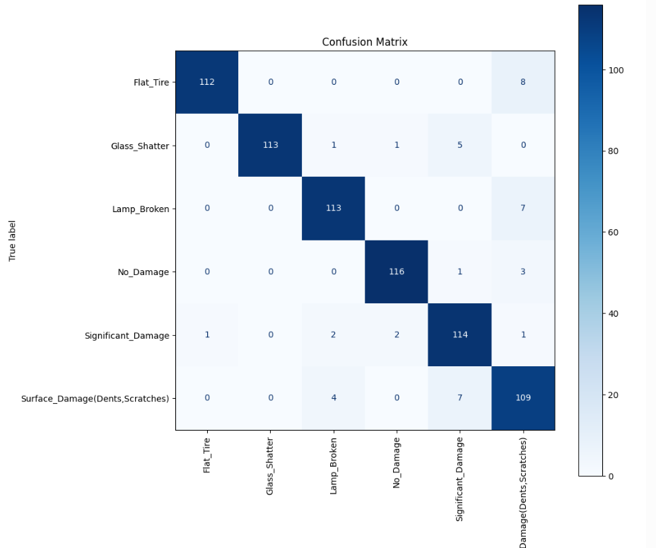
Let’s check the confusion matrix to see whether or not pretrained model still suffers from notable confusion.

Slide 28
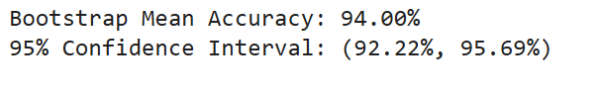
Using bootstrapped sampling to develop roughly approximated 95% confidence interval for the Resnet50 model:
100k bootstrapped samples used
Result:

Slide 29
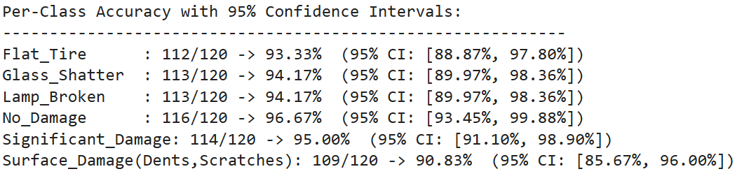




Using binomial distribution for approximating 95% confidence interval for per class accuracies.

Slide 30
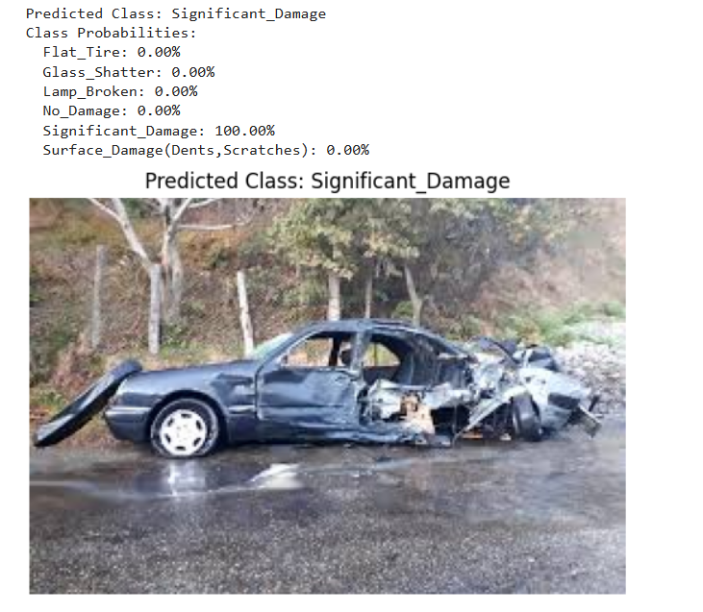
Testing the pretrained model on the same picture as scratch was tested

Slide 31
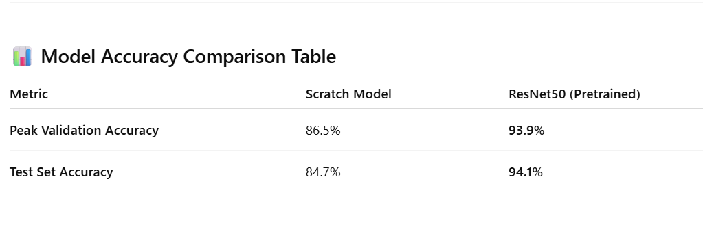
Comparison of scratch vs pretrained model results.

Slide 32
Potential improvements if data was available :
I would add missing parts classes
I would also add interior damage assessment related classes
I would increase number of pictures in the train set to boost the accuracy of both scratch and pretrained models
I would increase number of pictures in the train and validation sets too to make inferences that are statistically stronger, while maintaining balance of the Validation and Test in each class.

Slide 33
Thank you for your attention!
Any questions?

